Slide 1
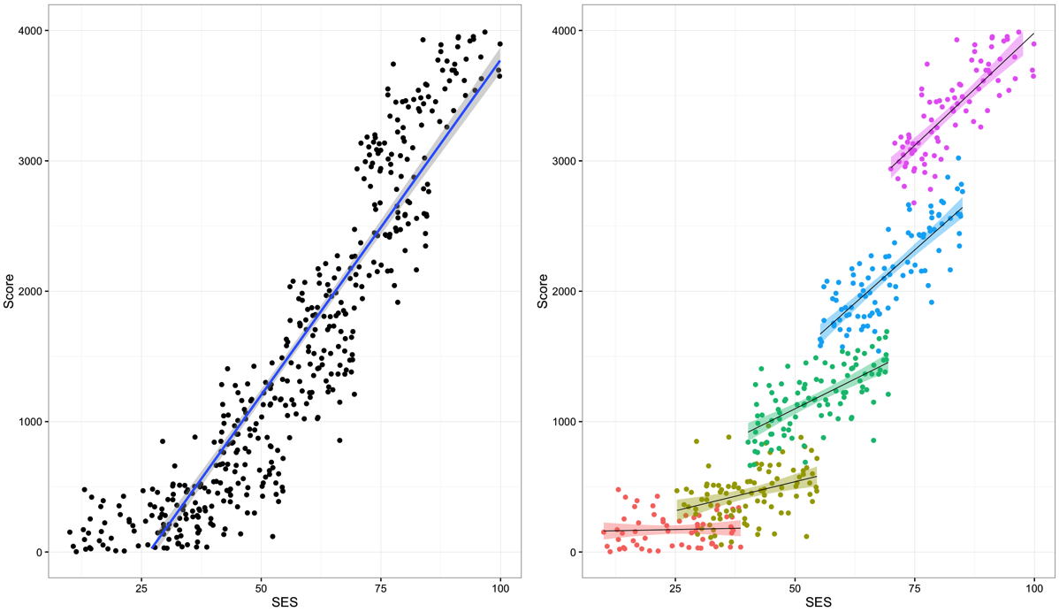
Synthetic Data Representing Educational Data
https://www.r-bloggers.com/multilevel-modeling-of-educational-data-using-r-part-1/

Slide 2
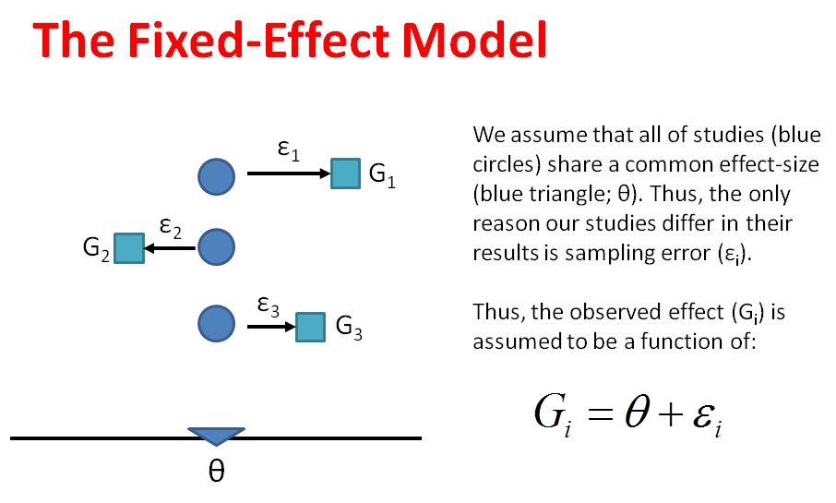
http://4.bp.blogspot.com

Slide 3
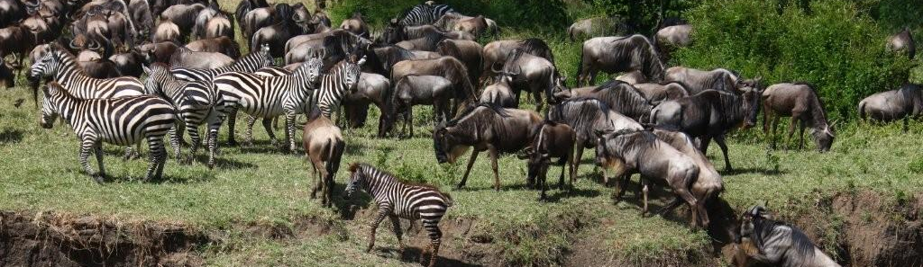
Problem
What if we want to model:
  Changes in a group over time
    Group by time slices (month, year)
  Behavior of multiple species in same area
    Group by species
  Look at student performance between classes, schools, districts?
    Multiple spatial scales
Notes:
Are these independent?

Slide 4
Example
Create a linear regression model that predicts test scores based on income in an area
Within a class, scores might vary based on student’s family income
Within a school, scores might vary based on teachers
Within a district, scores might vary based on property value around the school
Notes:
We could write an equation for one class but their might be other variables that need to be modeled at different “levels” of the model

Slide 5
Mixed Models a.k.a. Multi-Level Models
Models have multiple levels (typically 2)
The coefficients of one level of the model become the dependent variable of the second level of the model
The first level “groups” data, the second level models coefficients between groups
Also known as:
  Mixed Effects Models
  Hierarchical Models (more general term)
  Random Effects Models

Slide 6



Multi-Level Models
Level 1:
$$y_{ij}=β_{0j}+β_{1j}(x_{ij})+e_{ij}$$
Level 2:
$$β_{0j}=y_{00}+y_{01}w_{j}+u_{0j}$$
$$β_{1j}=y_{10}+u_{1j}$$

Slide 7
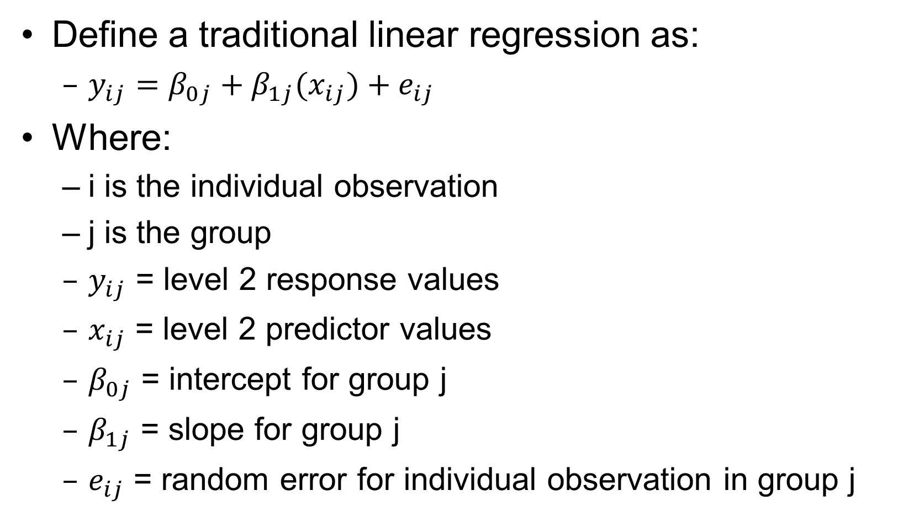
Level 1
Define a traditional linear regression as:
  $y_{ij}=β_{0j}+β_{1j}(x_{ij})+e_{ij}$
Where:
  i is the individual observation
  j is the group
  $y_{ij}$ = level 2 response values
  $x_{ij}$ = level 2 predictor values
  $β_{0j}$ = intercept for group j
  $β_{1j}$ = slope for group j
  $e_{ij}$ = random error for individual observation in group j

Slide 8
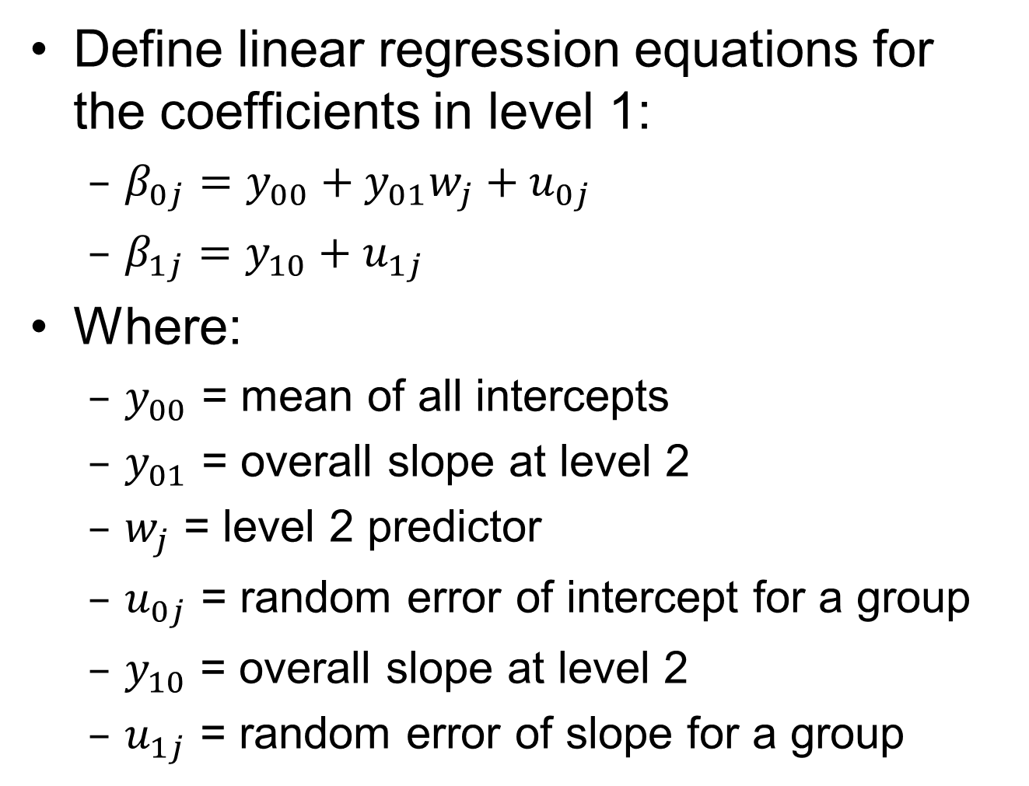
Level 2
Define linear regression equations for the coefficients in level 1:
  $β_{0j}=y_{00}+y_{01}w_{j}+u_{0j}$
  $β_{1j}=y_{10}+u_{1j}$
Where:
  $y_{00}$ = mean of all intercepts
  $y_{01}$ = overall slope at level 2
  $w_{j}$ = level 2 predictor
  $u_{0j}$ = random error of intercept for a group
  $y_{10}$ = overall slope at level 2
  $u_{1j}$ = random error of slope for a group

Slide 9
Level 1
Slopes and/or intercepts in all groups:
  Have the same value
  Are non-randomly varying
    Can be predicted at level 2
  Are randomly varying
    Each has their own slope and intercept

Slide 10
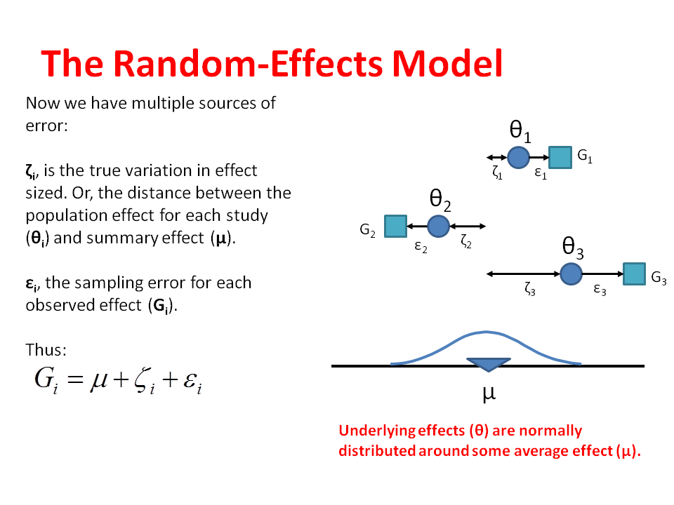

Slide 11
Example
Modeling age of herbivores
  Sample includes wildebeest and zebras
  Predictor could be forage quality
Overall average is based on both populations

Slide 12
Mixed Models
Contains Fixed and Random effects
Fixed:
  Only random effect is sampling error
Random:
  Explanatory variables from random distribution
  Effect is not directly correlated to response
Also known as:
  Mixed Effects Models

Slide 13
Assumptions
Same assumptions hold (linearity, homoscedasticity, residuals normally distributed) within each group
The observations are grouped:
  Homoscedasticity can vary between groups
  Independence
    Groups can be more alike than between groups

Slide 14
Types
Linear Mixed Models (LMM)
Generalized Linear Mixed Models (GLMM)
Generalized Additive Mixed Model (GAMM)
  Treats smoothing functions as coefficients in a level 2 model
  Example:
    McIntosh, R. et. al., 2015, Drivers and annual estimates of marine wildlife entanglement rates: A long-term case study with Australian fur seals

Slide 15
In R
Linear: lme() – package stats
Generalized Linear: lmer() - package lme4
gamm() – package mgvc
  Performs poorly with binary data, not as stable as gam()
gamm4() – package and function
  More stable than gamm()
  See other issues

